Slide 1
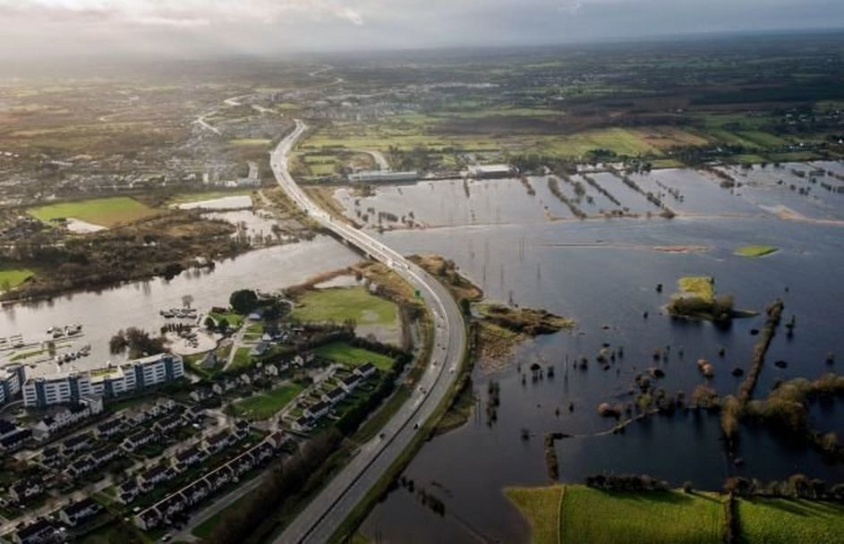
Living in your landscape
Learning from the past to prepare for the future

Slide 2
Living in your landscape
Objectives
  Understanding the concept of geohazards and resilience
  Identifying the different possible geohazards in your landscape
  Learn about the geological features that may contribute to geohazards in your area
  Examine flood risks and management strategies in your area
  Using historic and present day maps analyse any future risks
  Learn about community preparedness and response strategies for geohazards
  Work together to develop a warning system for your community
  Explore how climate change might affect future geohazards.
Notes:
<numéro>

Slide 3
Living in your landscape
Aims for students
  Explain the concept of geohazards
  Describe the rock types in their region and how they may have an impact in their area
  Describe past and possible future flooding in the area
  Provide a community warning system and action plan
  Understand how climate change may impact their local area
Notes:
<numéro>

Slide 4
Example of Assessment
Can be altered to suit different groups
Percentage | Descriptor | Criteria achieved based on group work and presentation of findings
90-100 | Distinction | Excellent group work, work load shared appropriately, evidence of further research, all points covered, findings identified and excellent presentation of findings
75-90 | Higher Merit | Very good group work, workload shared, some further research evident, most points covered, findings identified and very good presentation of findings
55-75 | Merit | Good group work, medium sharing of workload, little further research evident, points covered in small detail, basic findings identified,
40-55 | Achieved | Disjointed group work, poor sharing of workload, no further research evident, points not adequately addressed in a basic way, no findings identified, poor presentation of findings in general
20-40 | Partially achieved | Little to no group work, Group not collaborating in a basic manner, 1 or 2 students in group attempted work, very poor findings evident, very poor presentation of findings
0-20 | Not Graded | No group work, no roles/work shared, very little progress made, incomplete/no presentation of findings
Notes:
<numéro>

Slide 5
Lesson One to Four
Objectives
    Research relevant keywords and record
    Research and record rock types in area
    Research and record
      water resources (rivers, lakes and aquifers) and navigation,
      soil and drainage (farm land quality),
      other natural resources (mining, fishing, etc...),
      woodland,
      energy potential (wind, solar, geothermal or even peatland)
    Analyse why the town was built on that site

Slide 6
Keywords
Define the following keywords
Resilience:
Geohazards:
Groundwater flooding:
Community risk:
Landscape:
Natural resources:
Weather warning:
Synoptic maps:

Slide 7
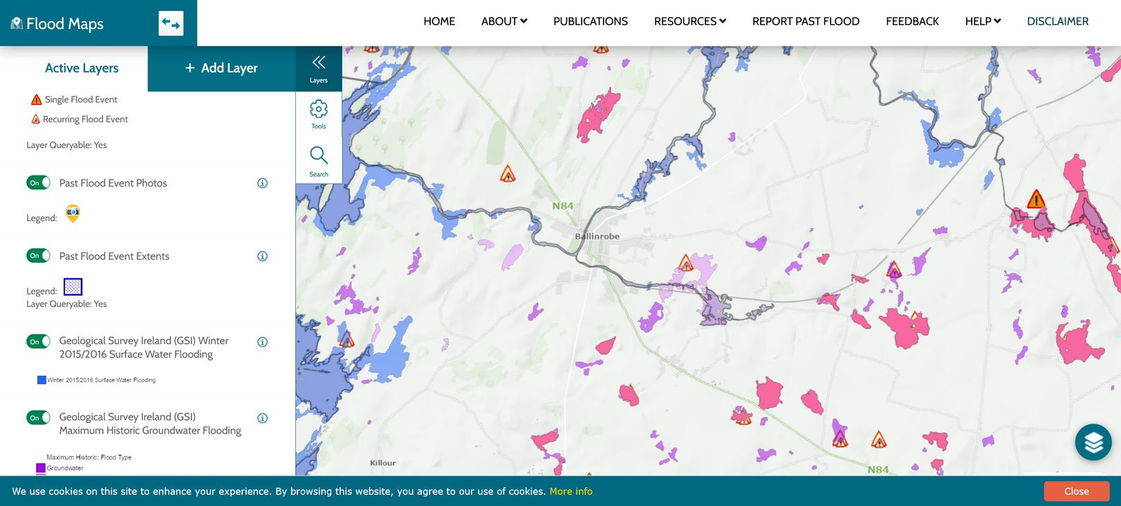
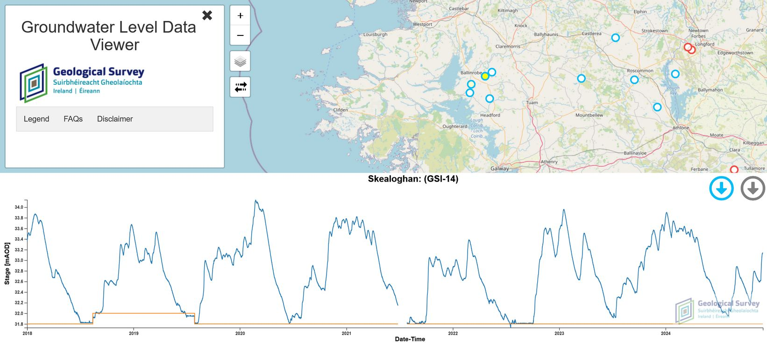
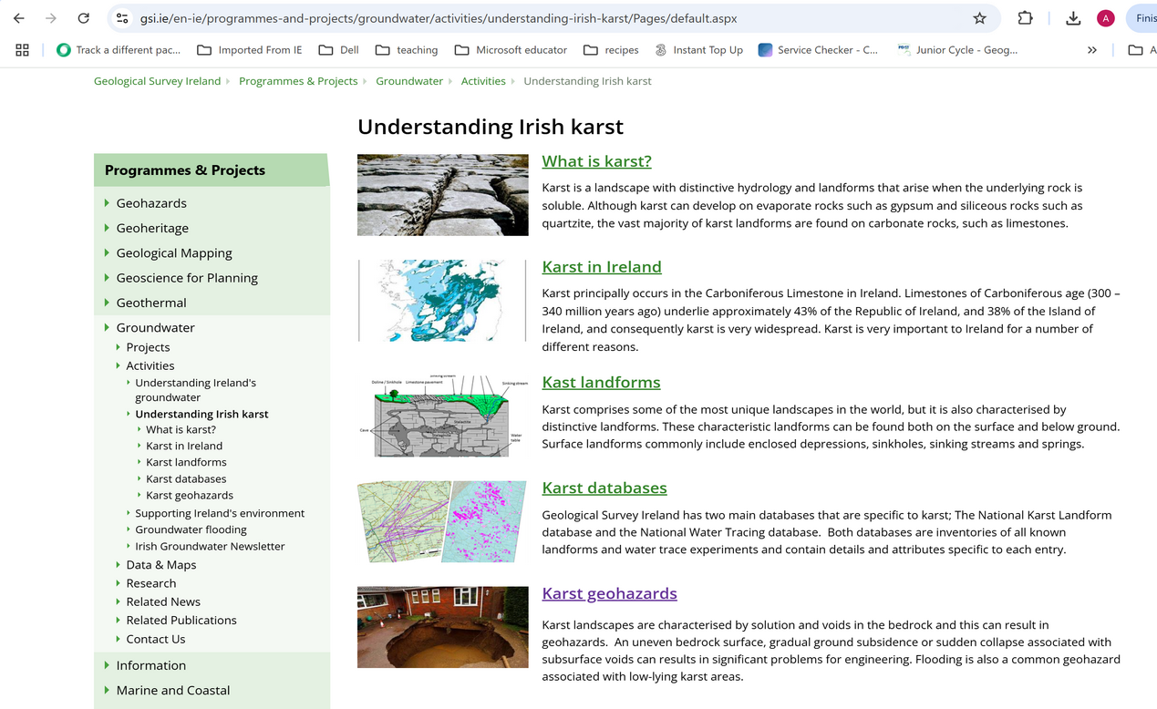
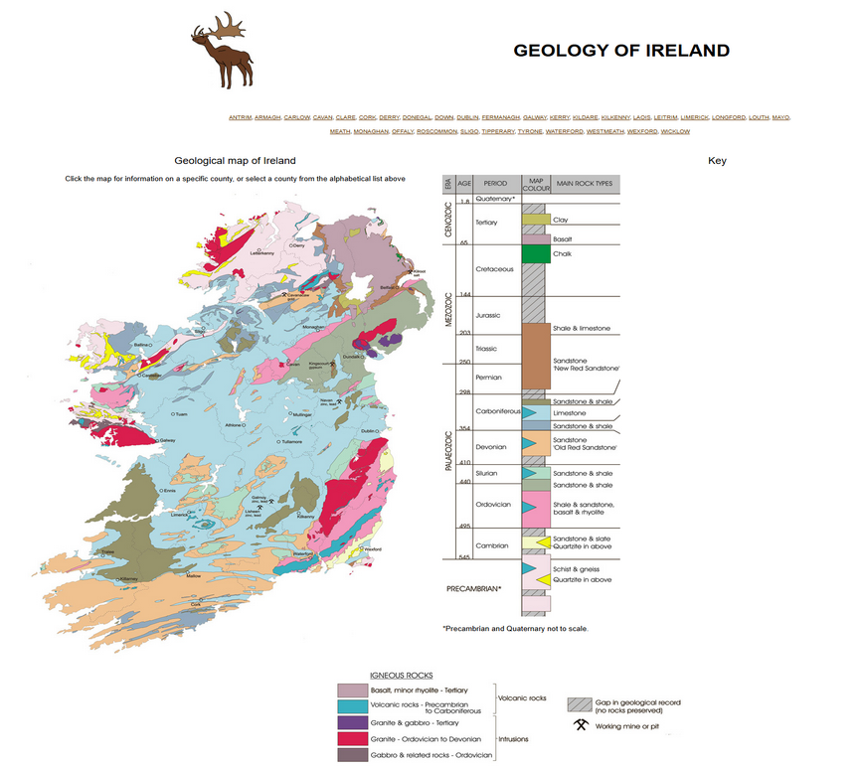
Lesson One to Four
Resources
    Map viewer ; Google maps, Heritage Maps, Scoilnet
    Explore information on Geological history; Geopark, Geoschol, GSI
    Map viewers on geoHazards
      Landslides (GSI)
      Floods (GWlevel, Flood maps)
    Map viewers on mineral resources
      Soils, aquifers, Minerals, Geothermal (GSI)
      Water quality (EPA)
Notes:
<numéro>

Slide 8

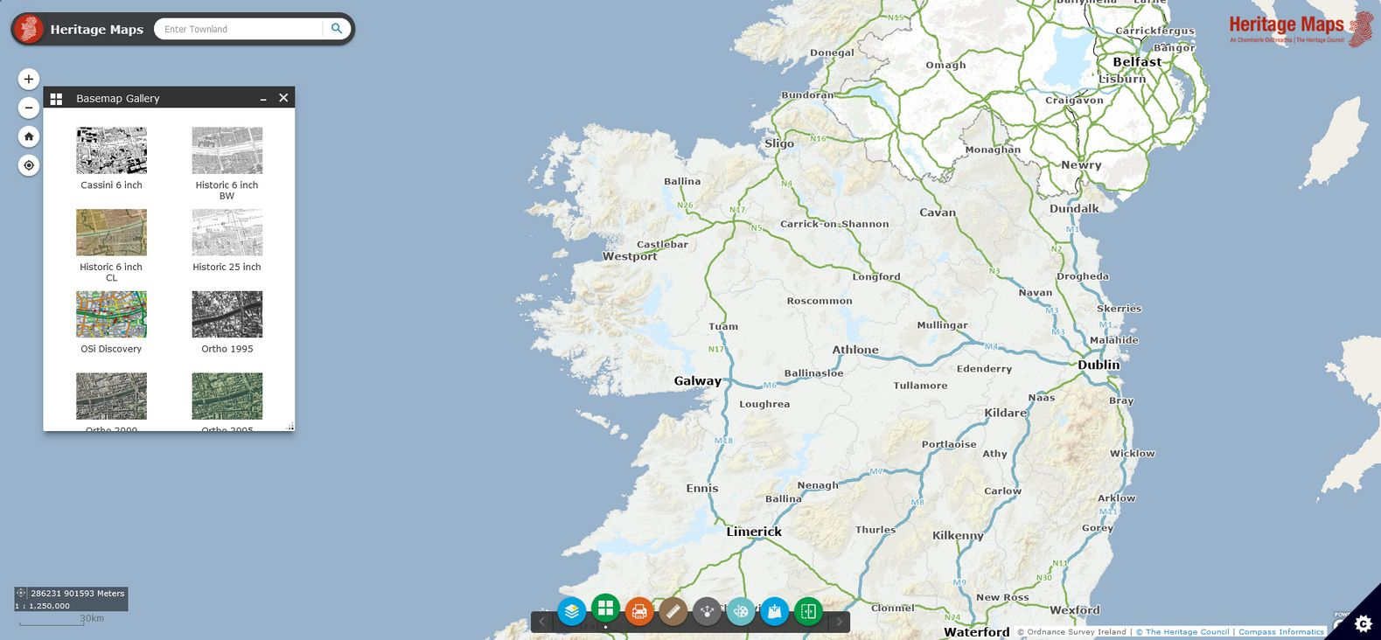
Heritage Maps
Www.heritagemaps.ie (press X when asked about arcGIS account, select basemap gallery , then select the historic maps...)
Notes:
<numéro>

Slide 9
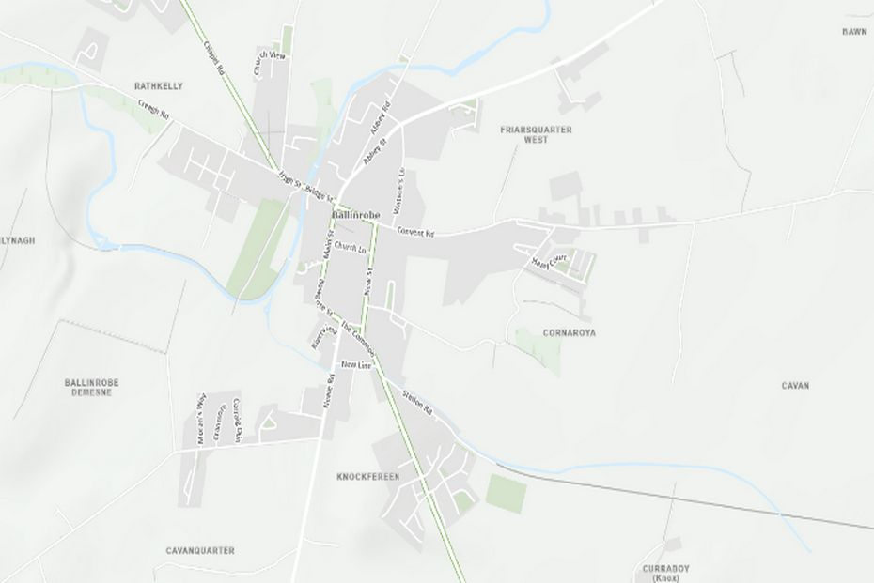
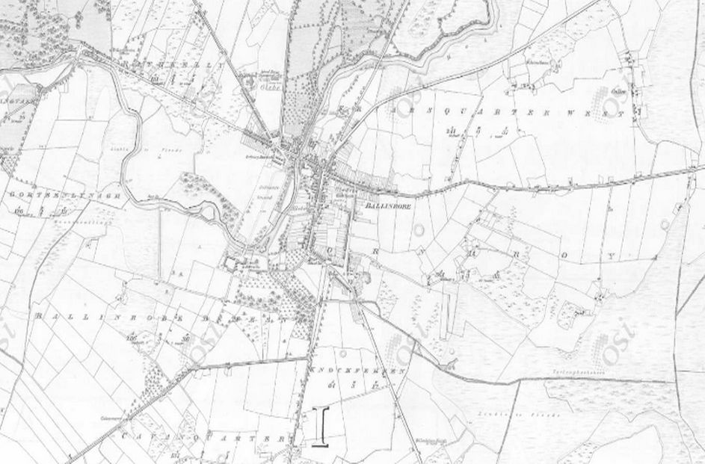
Comparison maps Historic V Present day
Example for Ballinrobe, co. Mayo

Slide 10
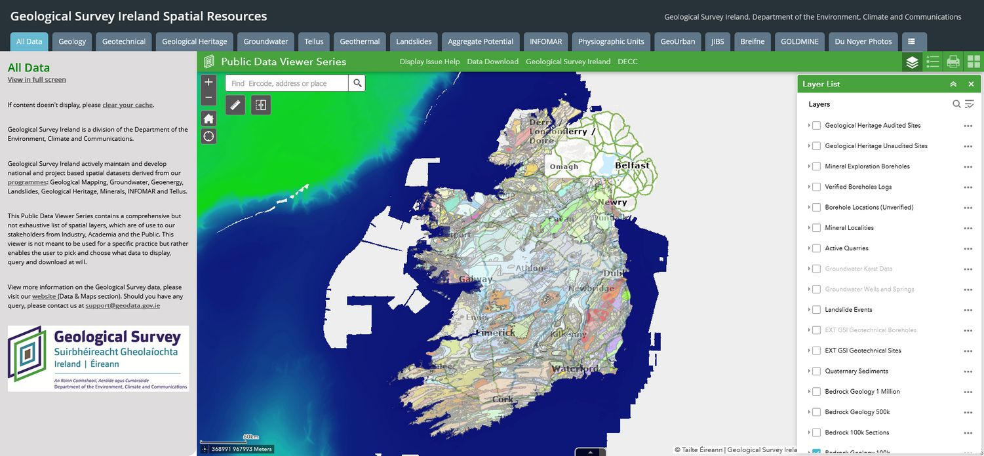
Geological Survey Ireland viewer
Www.gsi.ie (select data and maps then “click here for access to maps”)
Select the relevant tab at the top of the maps, zoom in or search for your area, tick on the relevant layer of information on the right, click on the map for more information
Notes:
<numéro>

Slide 11
Geoschol
Www.geoschol.com (select ireland to go to the map of the country)
Click on your county to get the relevant geological story pdf
Notes:
<numéro>

Slide 12
Groundwater level
Www.gwlevel.ie: click on local data points for groudwater level record
Notes:
<numéro>

Slide 13
Flood maps
www.floodinfo.ie/map/floodmaps/: zoom in to your area and select the relevant layer for Past flood events, GSI groundwater flooding probability maps or National indicative fluvial mapping
Notes:
<numéro>

Slide 14
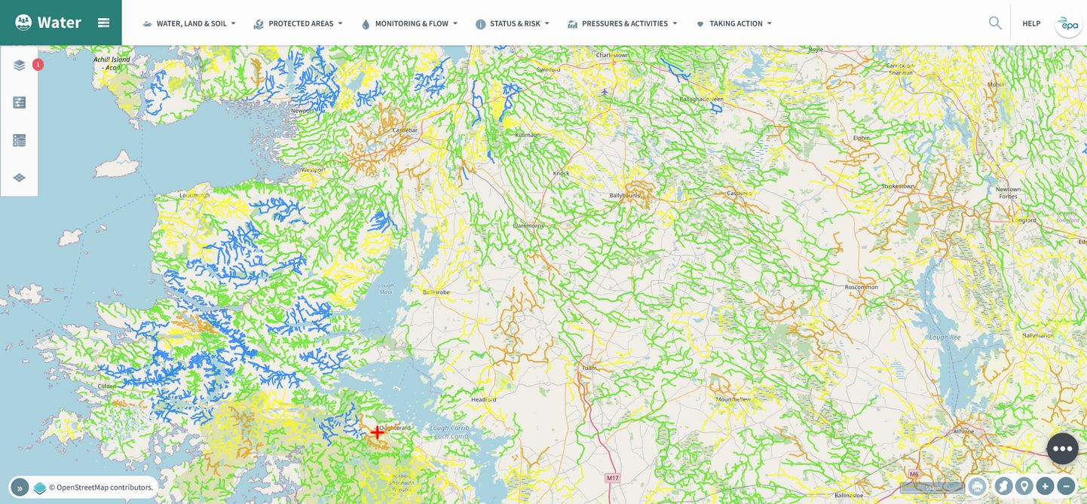
Water quality (EPA maps)
https://gis.epa.ie/EPAMaps/Water : zoom in to your area, check the status of local water bodies by hovering on “Status & Risk” at the top and switching on the relevant layer of information. You can click on the map for more information
Notes:
<numéro>

Slide 15
Lessons Five to Eight
Objectives
  Analyse and record geohazard risks to area
  Survey and record findings of local business – experiences of past events
  Map areas vulnerable to hazards
  Impact that climate change might have on future geohazards and on vulnerable areas

Slide 16
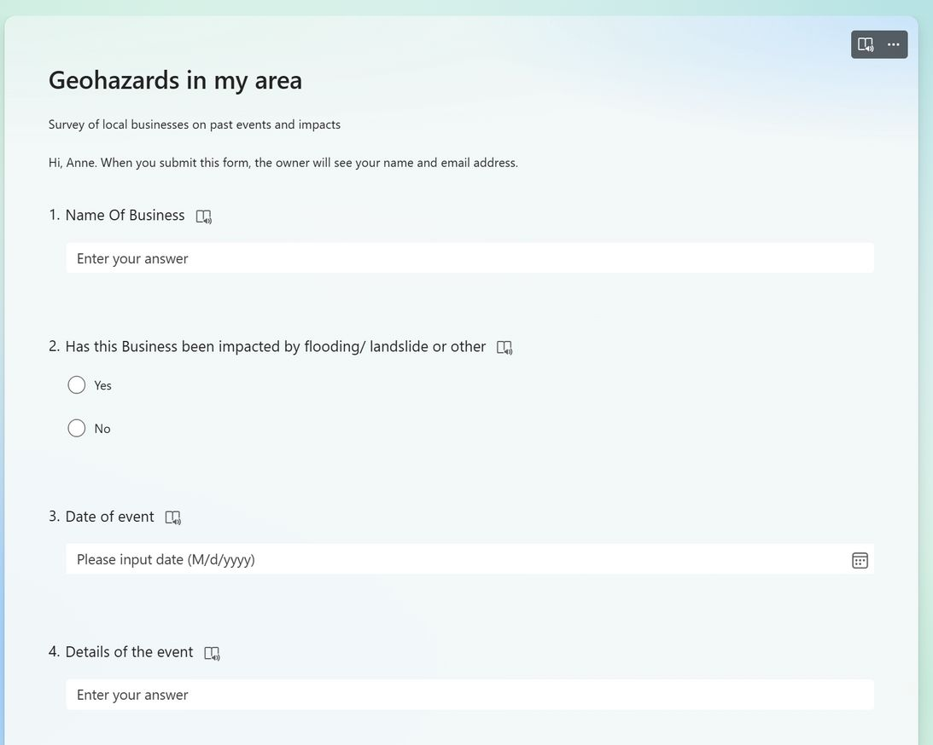
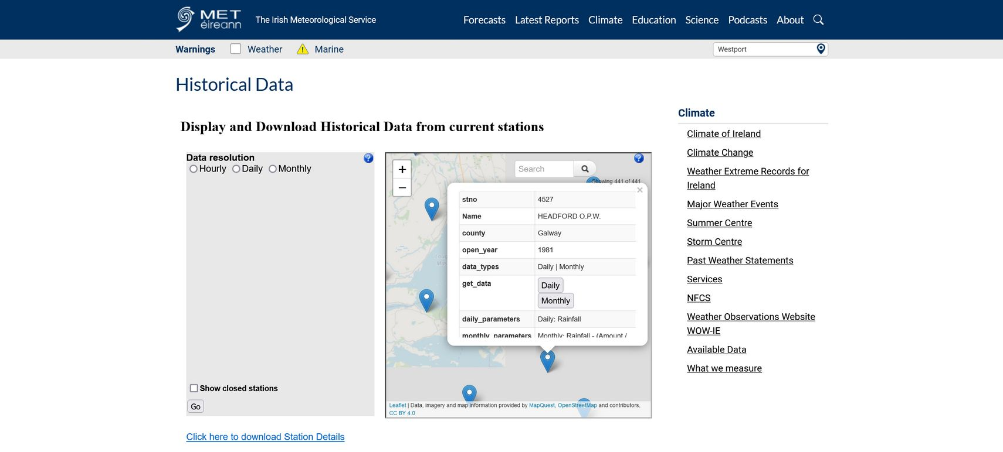
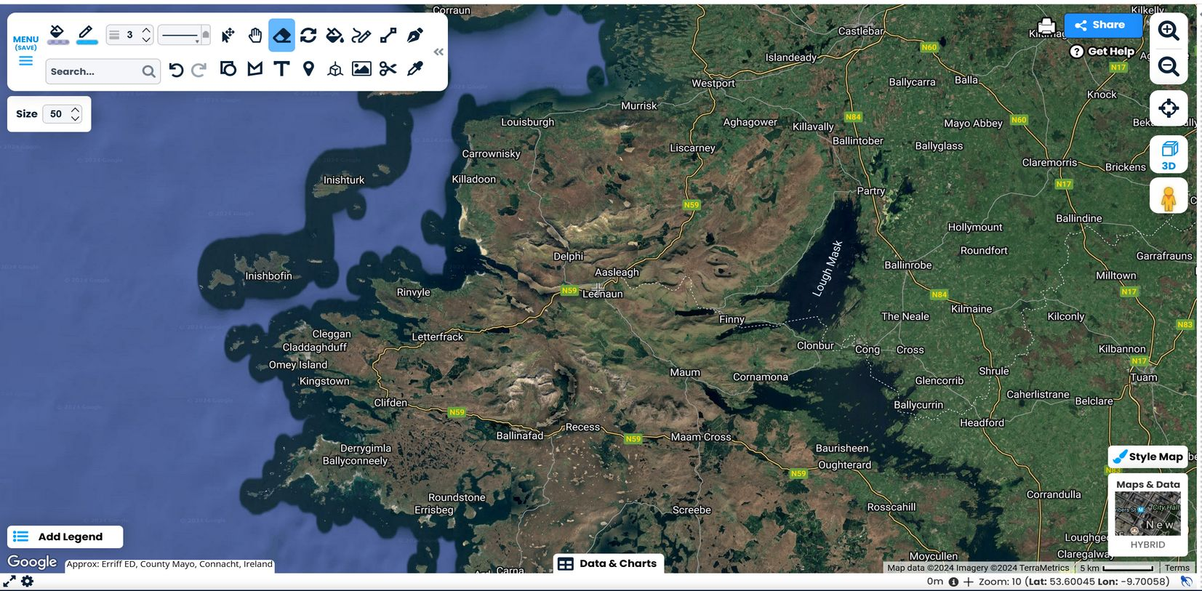
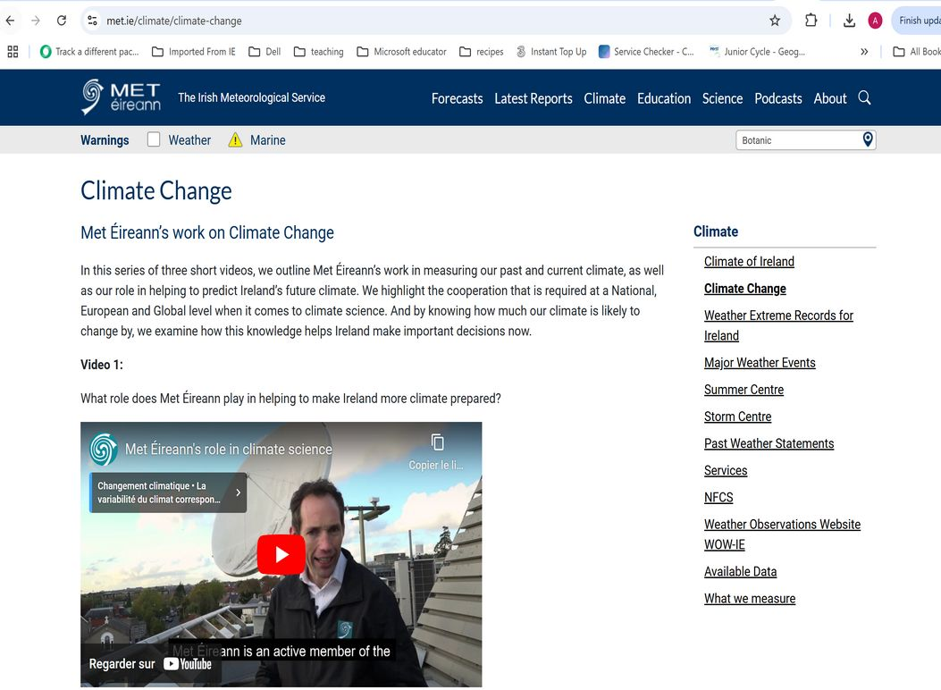
Lessons Five to Eight
Resources
  Historical news articles and videos/pics about past events
  Historical rainfall data (MetÉireann)
  How to build and analyse a survey
  How to build a simple map

Slide 17
Historical rainfall data
https://www.met.ie/climate/available-data/historical-data : zoom in to your area, click on the weather station closest to your area. Look at the open-year date as you might want to select a station further away but with a longer data set. Select the type of data you need (hourly, daily or monthly)
Notes:
<numéro>

Slide 18
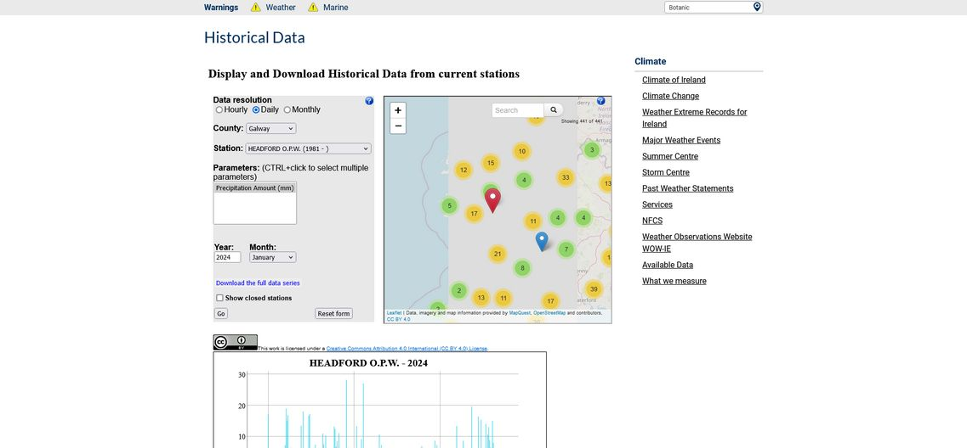
Historical rainfall data (cont.)
For daily data, type in the year and select the month then press go. The data will then appear in a graph below that can be saved. You can also select “download the full data series” to download a zipped .csv file of all the precipitation data recorded at the station to open in excel...
Notes:
<numéro>

Slide 19
Make your survey
See Appendix 2 in lesson plan
Notes:
<numéro>

Slide 20
Make your own map
See Appendix 1 in lesson plan
Notes:
<numéro>

Slide 21
Lesson Nine to Twelve
Objectives
  Research and record weather warning systems and emergency responses to geohazards
  Prepare questionnaire for guest speaker of Community response team
  Produce a community warning system
  One student from each group present their PowerPoint Presentation

Slide 22
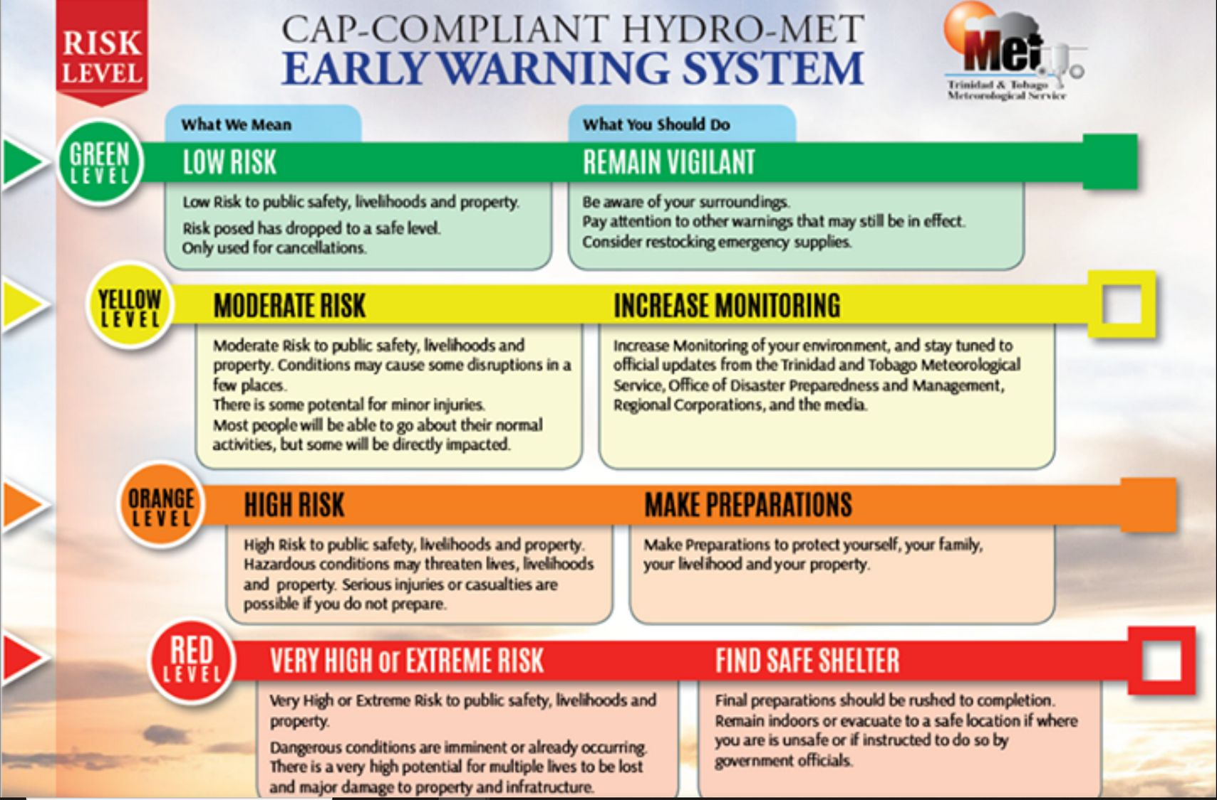
Lesson Nine to Twelve
Resources
  Information on weather warning system (MetÉireann, WMO)
  Information on emergency response (Government framework for major emergency management, Local Authority)
  How to build a Community Action Plan
Yellow | Not unusual weather. Localised danger.
Orange | Infrequent. Dangerous / disruptive.
Red | Rare. Extremely dangerous / destructive.

Slide 23
Community resilience plan
https://www.gov.uk/government/publications/community-resilience-resources-and-tools (for the UK but has good guidelines on what the plan would look like)
https://www.gov.ie/en/publication/30ce3-emergency-management/
(see in particular page 29 of the Framework for major emergency management on community resilience)

